Slide 1
FAIML (CS21206)
Spring 2026, IIT Kharagpur

Slide 2
Logistics
Course Name and code: Foundations of Artificial Intelligence and Machine Learning (FAIML), CS21206
Time: Thursday (03:00-04:55 pm), Friday (02:00pm-3:55 pm)
Venue: NC243 (Roll no.s ending with odd digits), NC244 (Roll no.s ending with even digits)
Course website: https://cs21206-iitkgp.github.io/sp2026/
CS21206 / FAIML | Introduction

Slide 3
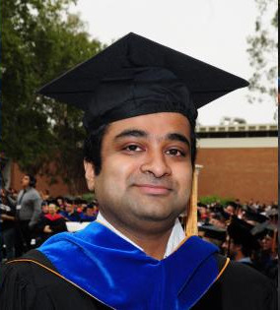
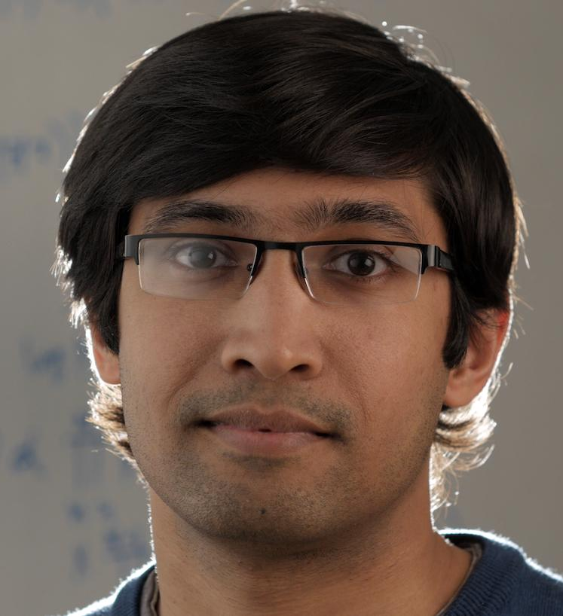
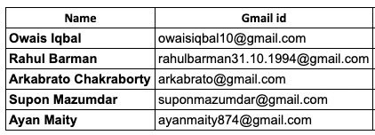
The Team
TAs
Instructors
Abir Das
Ayan Chaudhury
And YOU!!
CS21206 / FAIML | Introduction

Slide 4
Course Information
Books and References:
An Introduction to Statistical Learning by James, Witten, Hastie and Tibshirani
Applied Machine Learning by David Forsyth
Pattern Recognition and Machine Learning by Christopher Bishop
Artificial Intelligence: A Modern Approach, by Stuart Russell and Peter Norvig
More references specific to the lectures will be added in the course website as and when needed.
CS21206 / FAIML | Introduction

Slide 5
Course Information
Evaluation: Class Test (30%) – 2; Surprise Test (10%) – 2; Mid Sem (30%); End Sem (30%). [Tentative]
ClassTests and Semester Exams:
They will have a combination of Mathematical, Analytical and short coding based problems.
Tentative class test dates: I. 5 Feb II. 9 April
Will be taken outside class timings (evening is most likely)
CS21206 / FAIML | Introduction

Slide 6

Machine Learning
Source: https://xkcd.com/1838/
CS21206 / FAIML | Introduction

Slide 7
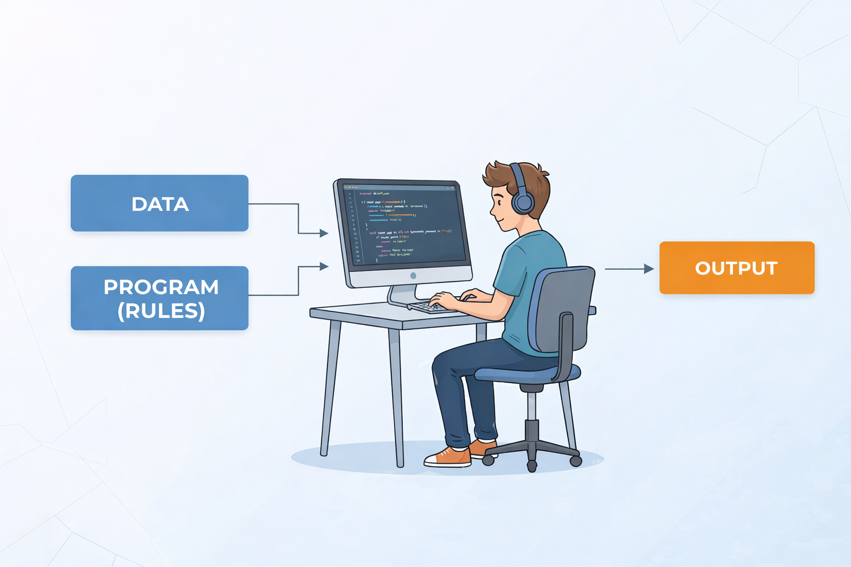
Traditional Computer Science
CS21206 / FAIML | Introduction

Slide 8
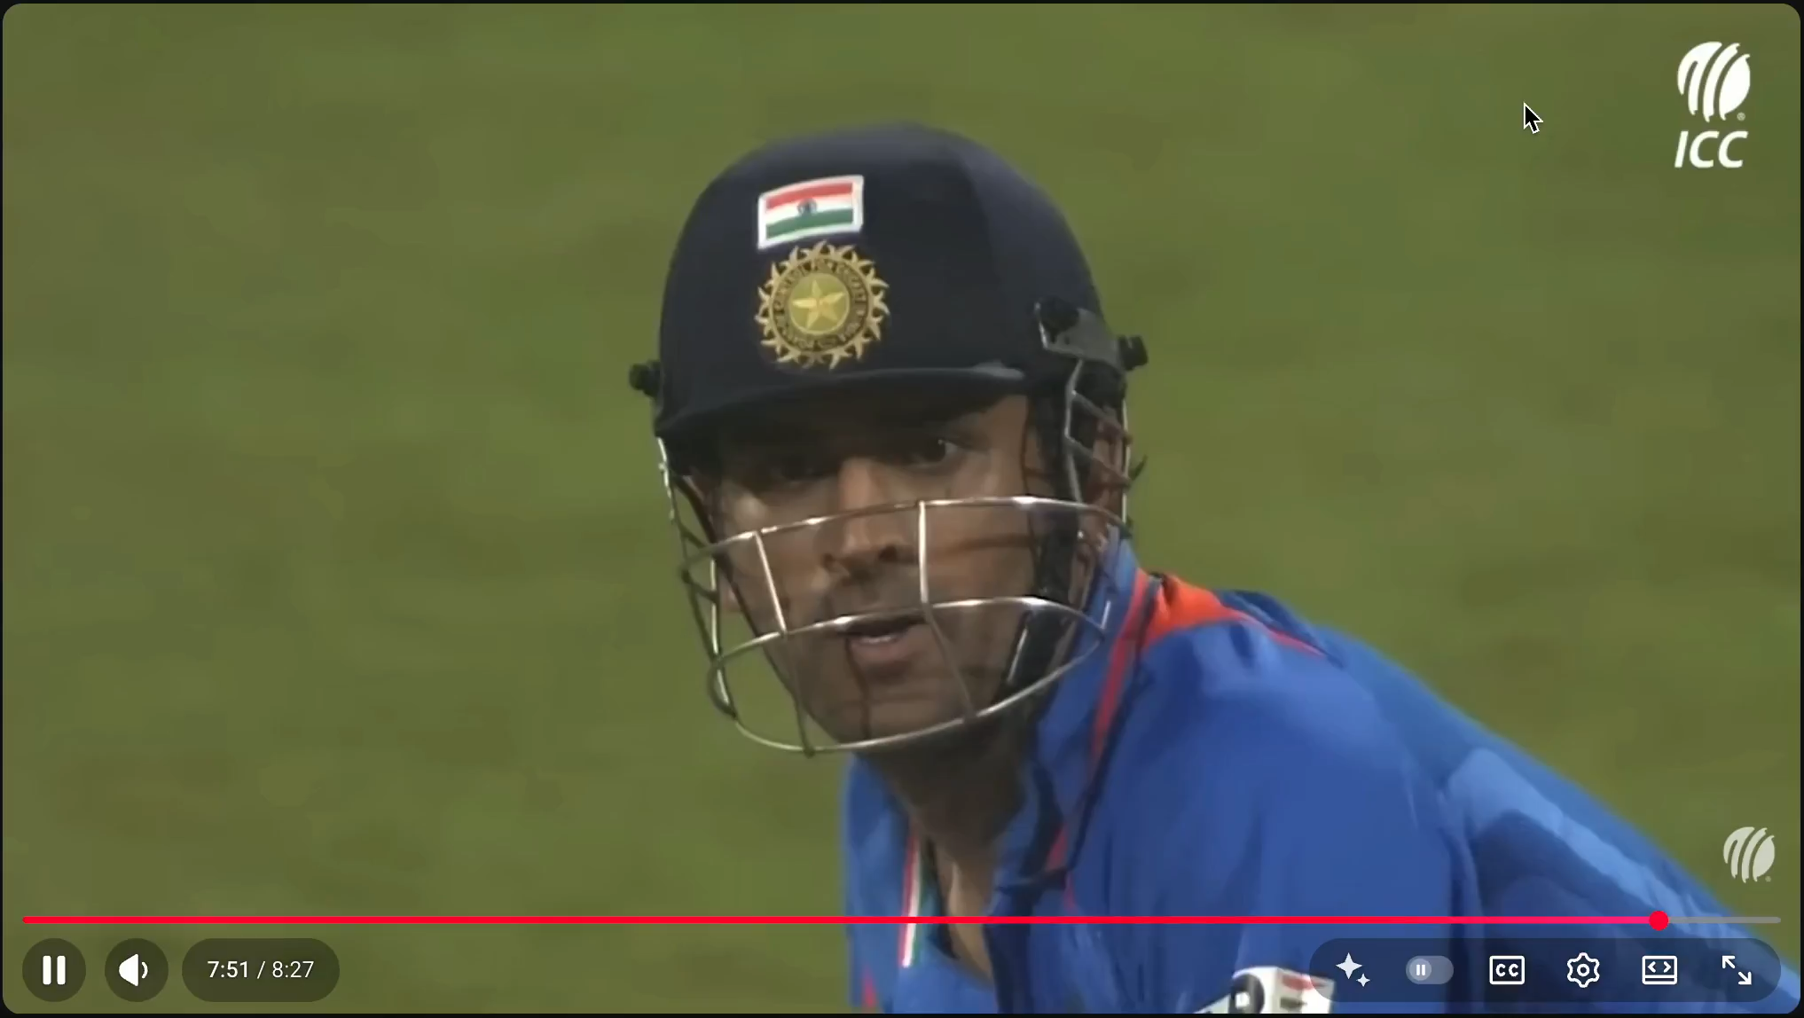
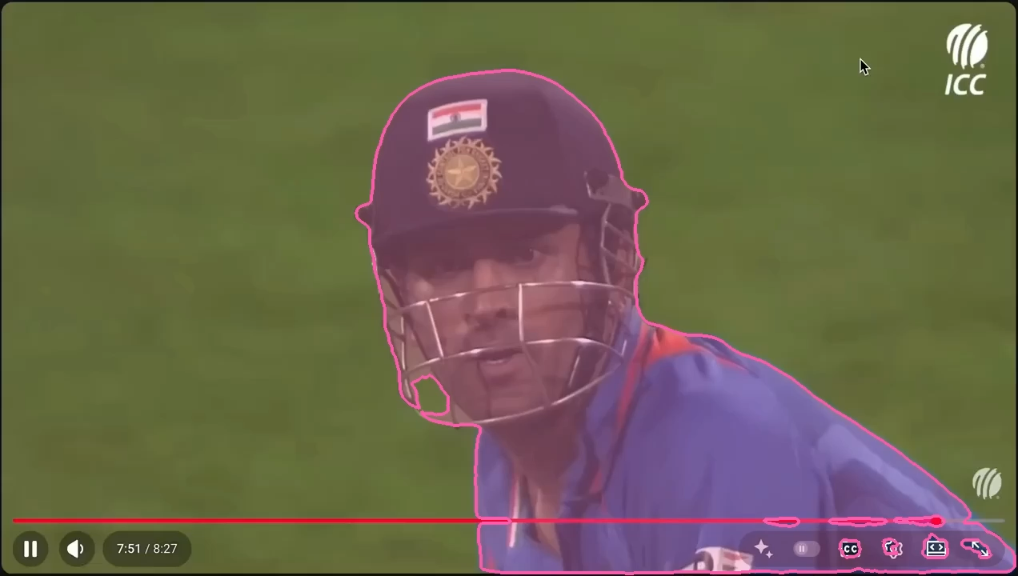
Traditional Computer Science
Video source: Youtube
Segmentation by https://aidemos.meta.com/segment-anything

Slide 9
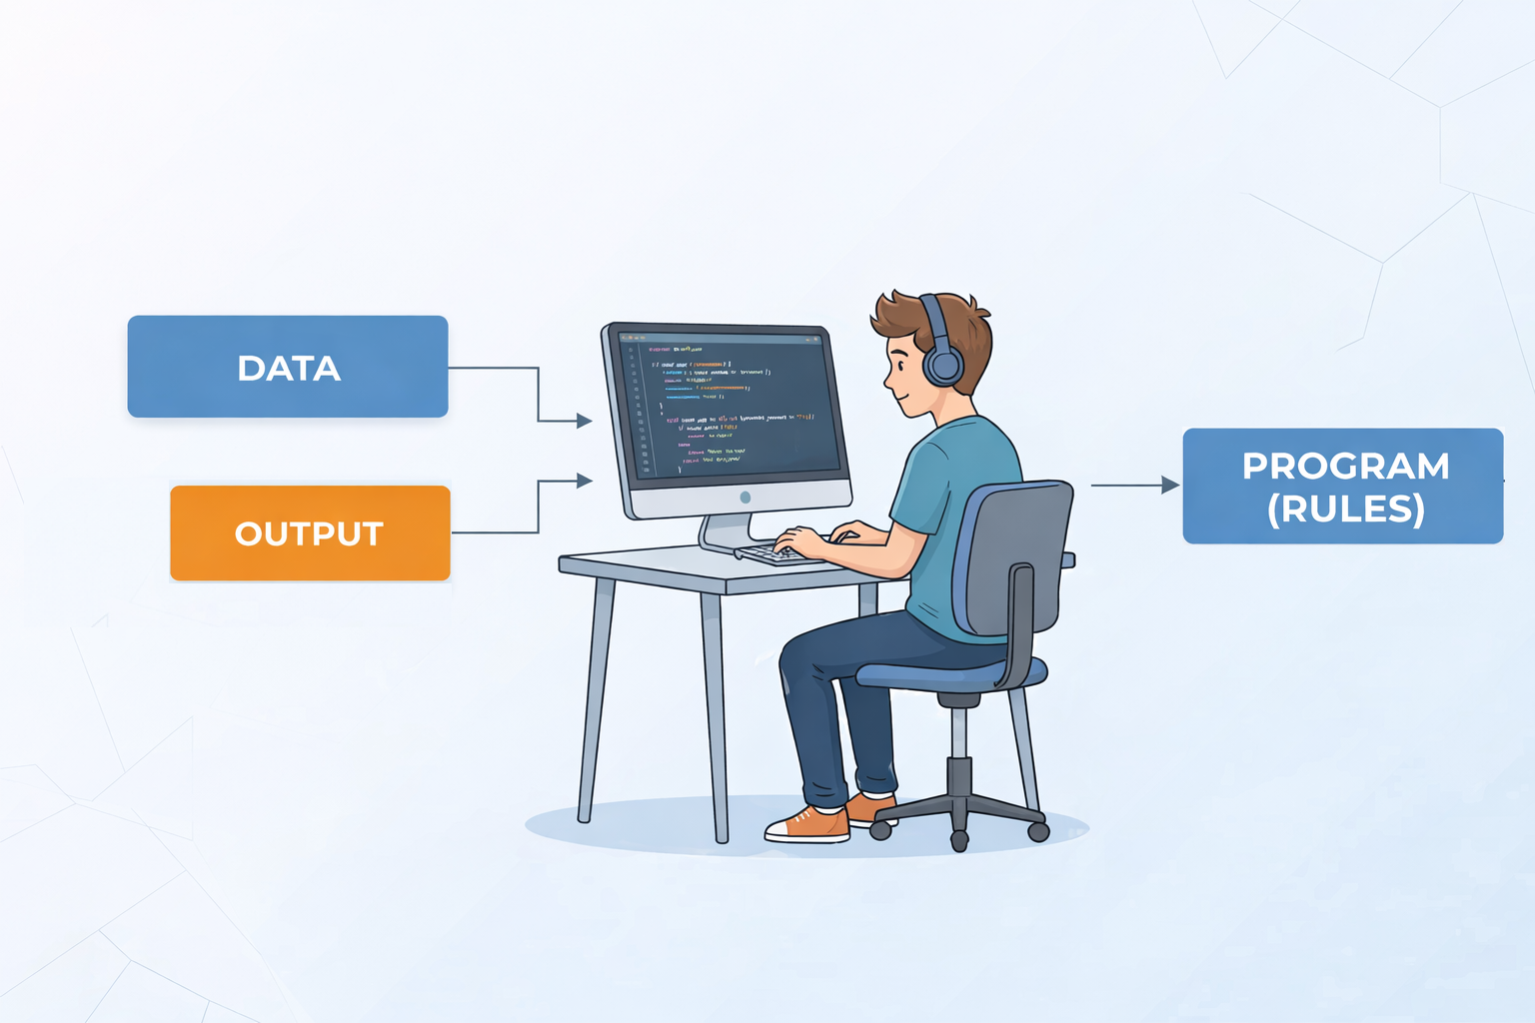
Machine Learning
Traditional Computer Science
Machine Learning
CS21206 / FAIML | Introduction

Slide 10
Machine Learning
Machine Learning
Training
Testing
CS21206 / FAIML | Introduction

Slide 11

Machine Learning Definition
Dictionary definition: a computational method that enables a computer to learn to perform tasks by analyzing a large dataset without being explicitly programmed.
By Arthur Samuel (1957): A field of study that gives computers the ability to learn without being explicitly programmed.
By Tom Mitchell (1997): A computer program is said to learn from experience E with respect to some class of tasks T and performance measure P, if its performance at tasks in T, as measured by P, improves with experience E.
Informally: Algorithms that improve on some tasks with experience.
CS21206 / FAIML | Introduction

Slide 12

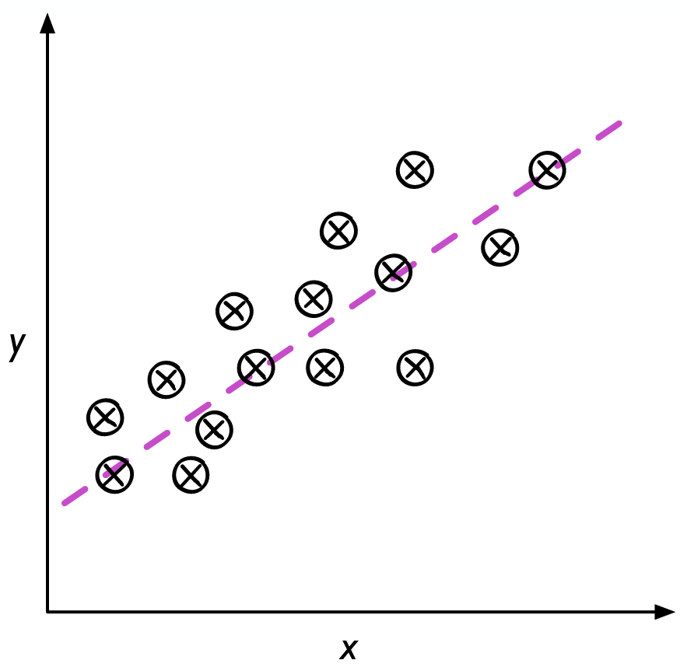


Categories of Machine Learning
Supervised Learning: Given a training set consisting of inputs and outputs, learn
to map novel, unseen inputs to outputs.
The novel inputs are called a test set.
Example: Digit Recognition
Example: House Price Prediction
Training set | Set of images and labels
input | Image features
output | Which digit is it [Categorical]
Training set | Set of Housing Data
input | Size, # Bedrooms, Age of house etc.
output | Price of such house [Continuous]
Classification
Regression
CS21206 / FAIML | Introduction
Notes:
What is the simple thing that can be done to recognize the test digits?

Slide 13
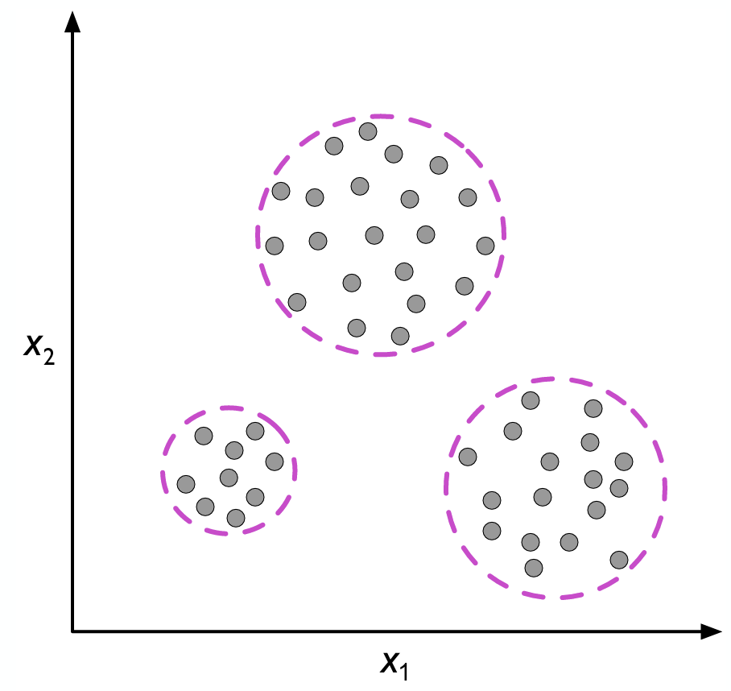
Categories of Machine Learning
Unupervised Learning: Output is not given as part of the training set.
Find models that explain data.
- e.g., Clustering, compressed representation etc.
CS21206 / FAIML | Introduction
Notes:
What is the simple thing that can be done to recognize the test digits?

Slide 14
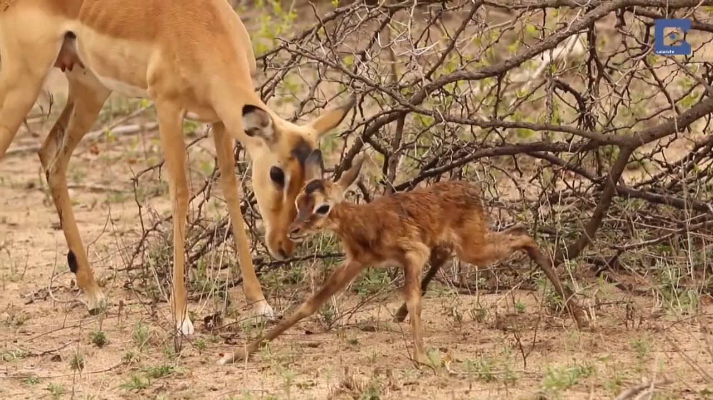
Categories of Machine Learning
Reinforcement Learning: “Goal-directed learning from interaction in an uncertain environment”
– Reinforcement Learning: An Introduction, Sutton and Barto, Second Edition
Agent:- The learner or the decision maker.
Environment:- The thing the learner interacts with.
Reward:- Rewards are measures defining what are the good and bad for the agent.
Goal:- to maximize the total reward “in expectation” over the long run.
Distinguishing feature of Reinforcement Learning:- The learner is not told which actions to take, but instead must discover which actions are most rewarding by trying them.
CS21206 / FAIML | Introduction
Notes:
What is the simple thing that can be done to recognize the test digits?

Slide 15
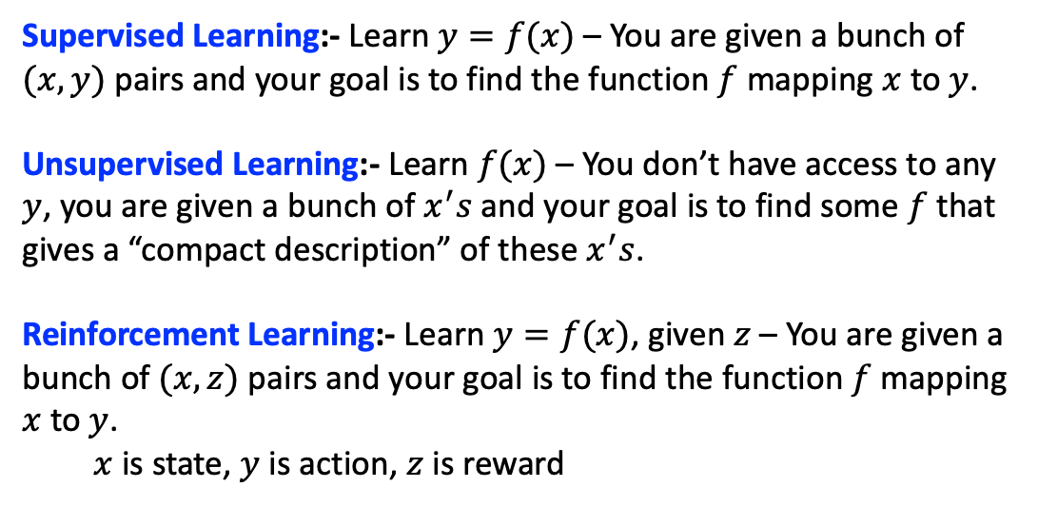
Supervised, Unsupervised and Reinforcement Learning
CS21206 / FAIML | Introduction
Notes:
What is the simple thing that can be done to recognize the test digits?

Slide 16
Thank You!!

